Slide 1
BRAIN TUMOR SEGMENTATION PROCESS
Md Ashiq Ul Islam Sajid (ID:20201225)
Rumaysa Mumtahana ( Id: 20101310)
Arjun Saha (Id : 22101370)

Slide 2
Objectives
Accurate and precise detection of tumours
Fast and efficient computation time
Improving diagnostic accuracy
Proper segmentation of tumour region from other segments

Slide 3
Introduction
In recent years, there has been an increasing interest in the Brain tumor s using the segmentation process. This technology allows for a more accurate and detailed understanding of the location and behavior of Brain tumor s within the body, which can lead to more effective treatment options and improved patient outcomes.

Slide 4
Brain tumor Segmentation
•Brain tumor segmentation is the process of identifying and separating Brain tumor s from other s in a tissue sample. This process is crucial in Brain tumor research as it allows for the spatial awareness of Brain tumor s and their behavior.
•Brain tumor segmentation is the process of identifying and separating Brain tumor s from other s in a tissue sample. This process is crucial in Brain tumor research as it allows for the spatial awareness of Brain tumor s and their behavior.
•Brain tumor segmentation is the process of identifying and separating Brain tumor s from other s in a tissue sample. This process is crucial in Brain tumor research as it allows for the spatial awareness of Brain tumor s and their behavior.

Slide 5
Analysis of Brain tumor s
Importance of Spatial Awareness
Spatial awareness of Brain tumor s is crucial in understanding their behavior and developing effective treatments. By analyzing the spatial distribution of Brain tumor s, researchers can identify patterns and predict their movement, which can inform targeted therapies.
Segmentation Process
Segmentation is a process of dividing an image into multiple segments, each representing a distinct object or feature. In the context of Brain tumor s, segmentation can be used to identify and isolate individual s for further analysis.

Slide 6
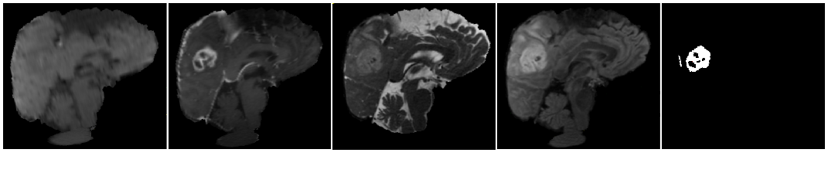
Methodology
Dataset Used:
BRaTS Dataset 2023:
T1 (spin-lattice relaxation)
T1-contrasted (T1C)
T2 (spin-spin relaxation)
Fluid attenuation inversion recovery (FLAIR) pulse sequences.
T1
T1c
T2
FLAIR
Ground Truth

Slide 7


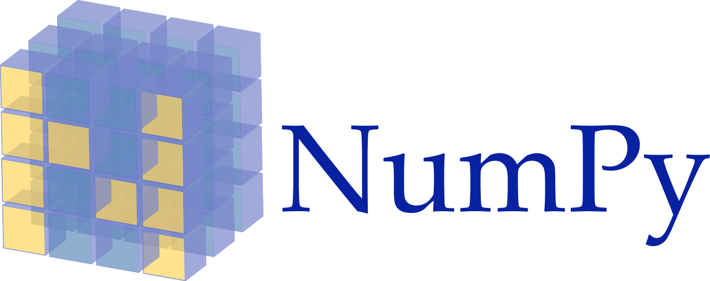
Data pre-processing
Tools we have used:
NiBabel
Tensorflow
Tensorflow’s Keras API
NumPy
Matplotlib
Sci-kit Learn
GLob

Slide 8
Data pre-processing
Data Characteristics
BraTS 2023 dataset with 1251 images in each class (T1, T1c, T2, FLAIR, and Masks).
Excluded T1 images for segmentation.
Combined T1c, T2, and FLAIR images into one volume.
Conversion to 2D Arrays
Original 3D images (240x240x155) were converted into 2D arrays.
Each row of the 2D array represented a 3D pixel or voxel.
Resulting in three channels: T1 contrasted, T2, and FLAIR.
Normalization
Normalization applied to each pixel independently.
Pixel values ranged from 0 to 1 for computational efficiency.
Images were then reverted to their original shape (240x240x155).

Slide 9
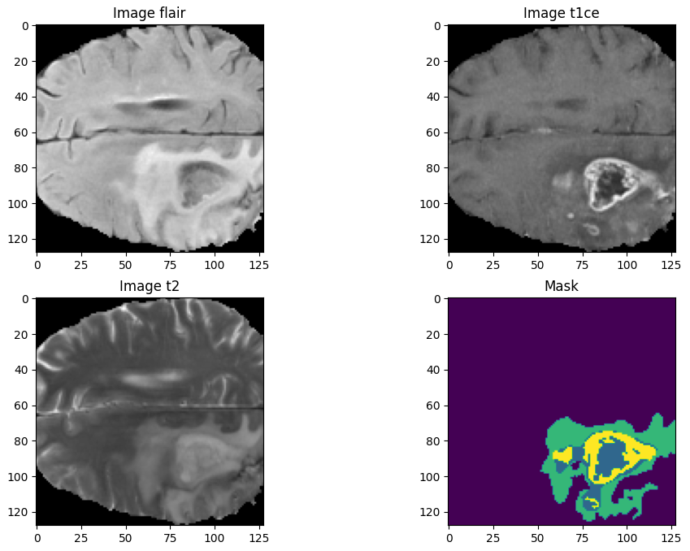
Data pre-processing
Cropping
Combined images were cropped and resized to 128x128x128x3.
Reducing computational complexity and focusing on relevant brain regions.

Slide 10
Data pre-processing
Combination of Images
All images (except T1 and Masks) were combined into one volume.
Input shape became 240x240x155x3 (T1c, T2, and FLAIR).
Mask Filtering
Annotated masks had four labels: 1 (NCR), 2 (ED), 3 (ET), and 0 (everything else).
Masks with labels 1, 2, and 3 were considered useful.
Images were selected for training if the total volume labels constituted at least 1% of the whole mask.
Images without useful labels were ignored.
Final Selection
After preprocessing, we selected 1151 images from 1251 images for model training based on the criterion of having at least 1% of useful volume with non-zero labels.

Slide 11
Methodology for 3D-Unet model
3D U-net Architecture
Training-Validation Split
Larger Training Dataset
He Uniform Kernel Initializer
3D-Unet Architecture Components
Contraction Path
Expansive Path
Softmax Activation

Slide 12
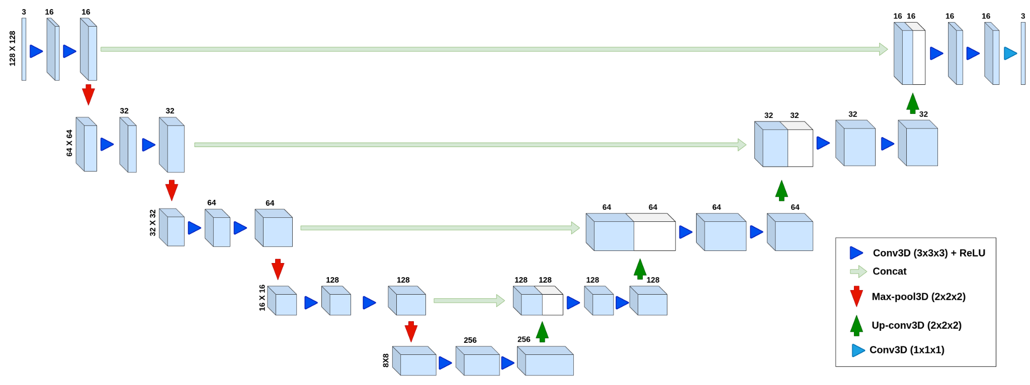
Model Architecture

Slide 13
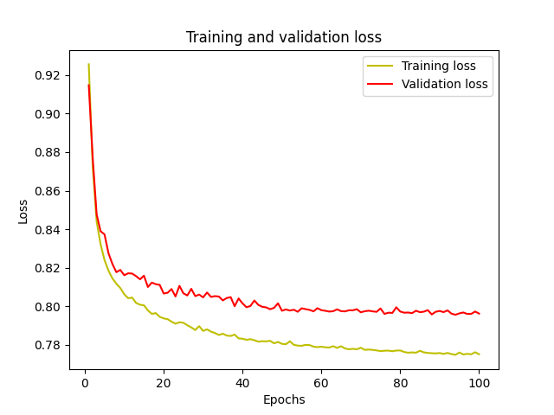
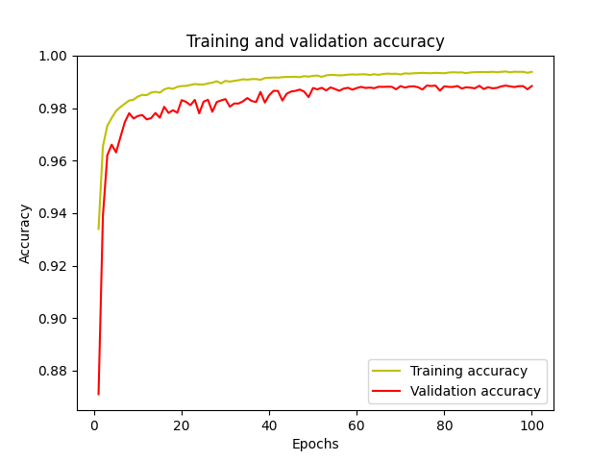
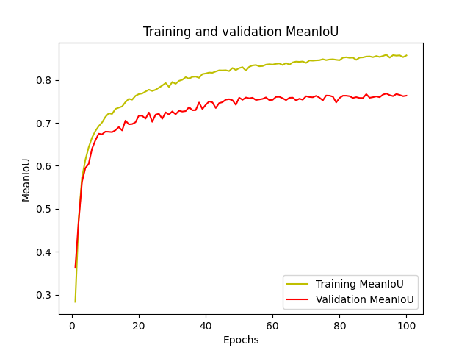
Training and Validation curves

Slide 14
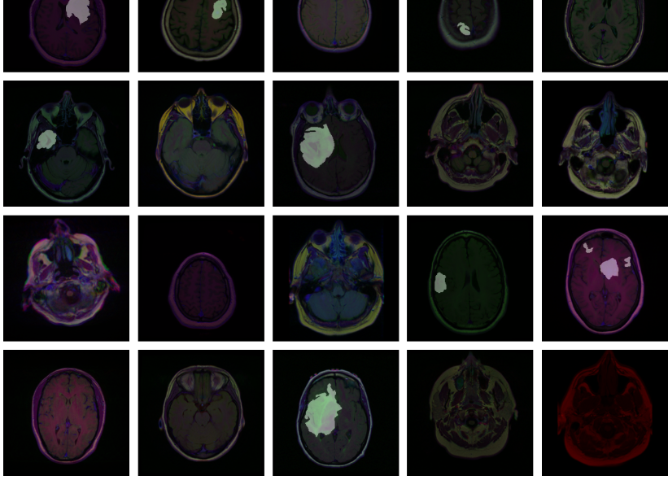
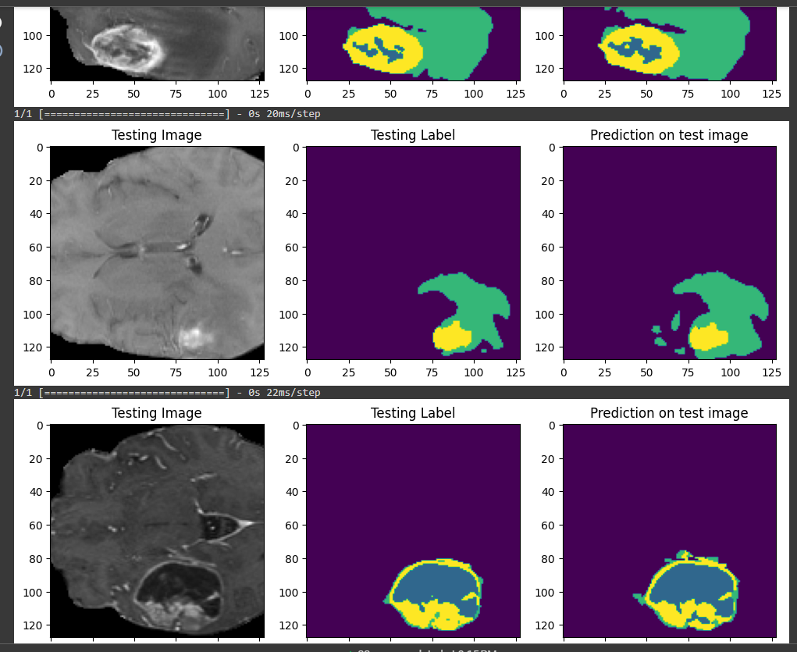
Dataset before cleaning
Dataset after cleaning

Slide 15
Results
Training Setup
Intersection over Union (IoU) Score
Loss Reduction
Accuracy Improvement
Further research needed for validation and refinement of models.

Slide 16
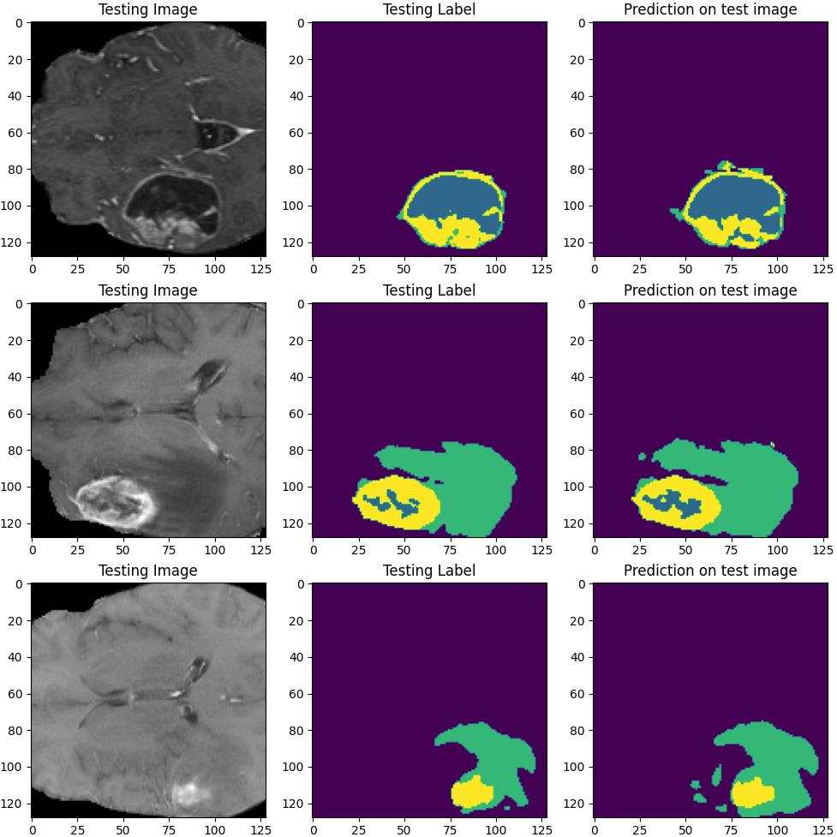
Results

Slide 17

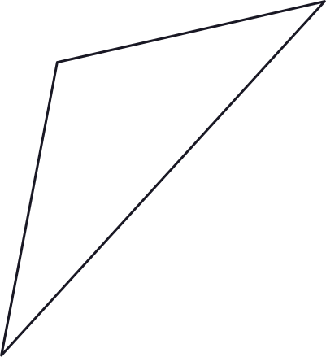
References
Article: "A Review on Deep Learning Techniques for the Segmentation of Tumor in Brain MRI"
Authors: Khushboo Garg, Manpreet Kaur
Published in: Journal of Digital Imaging (2019)
Article: "A Review on Automated Lung Brain tumor Detection and Prediction using Data Analytics and Machine Learning Techniques"
Authors: Nilanjan Dey, Amira S. Ashour, Simon James Fong, et al.
Published in: Journal of Healthcare Engineering (2019)
Article: "Deep Learning in Medical Image Analysis"
Authors: Dinggang Shen, Guorong Wu, Heung-Il Suk
Published in: Annual Review of Biomedical Engineering (2017)
Book: "Medical Image Analysis"
Authors: Atam P. Dhawan, Jasjit Suri
Published by: CRC Press (2011)
Article: "Recent Advances in Convolutional Neural Networks"
Authors: Alex Krizhevsky, Ilya Sutskever, Geoffrey E. Hinton
Published in: Neural Information Processing Systems (2012)

Slide 18
Thank You!

